Slide 1
Octank Finance
Security Data Platform
Rupesh Tiwari | AWS Senior Solutions Architect
rupeshti@amazon.com
2022-04-08
Notes:
Hello everyone, thank you for joining me today. Welcome on our 2nd meeting.
My name is Rupesh Tiwari, I am a senior solutions architect in Amazon Web services on our financial service team.
So, before we jump in, I was hoping we could do a quick round of introduction.
If you could tell me your name what your role is in the organization?

Slide 2
Agenda
Recap Solution Architecture
Demo
Live NetFlow-Enrichment
Performance and Monitoring
Costs of working solution
Deployment strategy
Review Deliverables & Next steps

Slide 3

Recap
Octank wants to build security data platform at AWS cloud to identify security anomalies in their network. Octank would like to develop a solution on AWS to analyze these large number of events and detect abnormal events in real time.
POC Key Requirements
Ingestion using Kafka
Stream processing using Spark
Normalization of datasets and enrichment as part of stream processing
Detection of abnormal events
1 million events per second ( for POC 250K events per second )
5 TB daily ingestion - Parquet

Slide 4
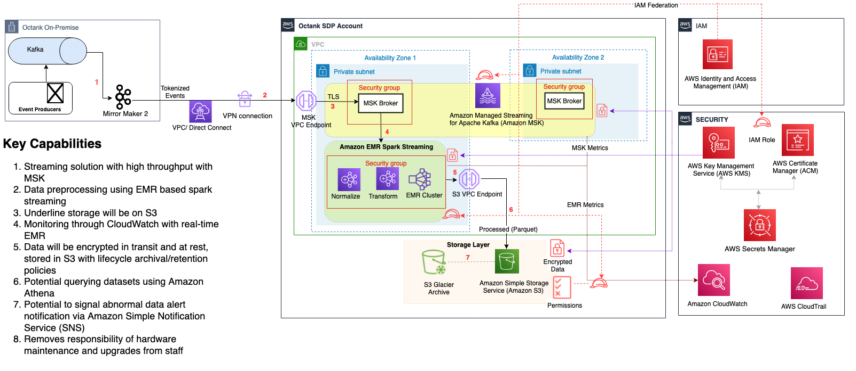
Proposed Architecture Recap

Slide 5
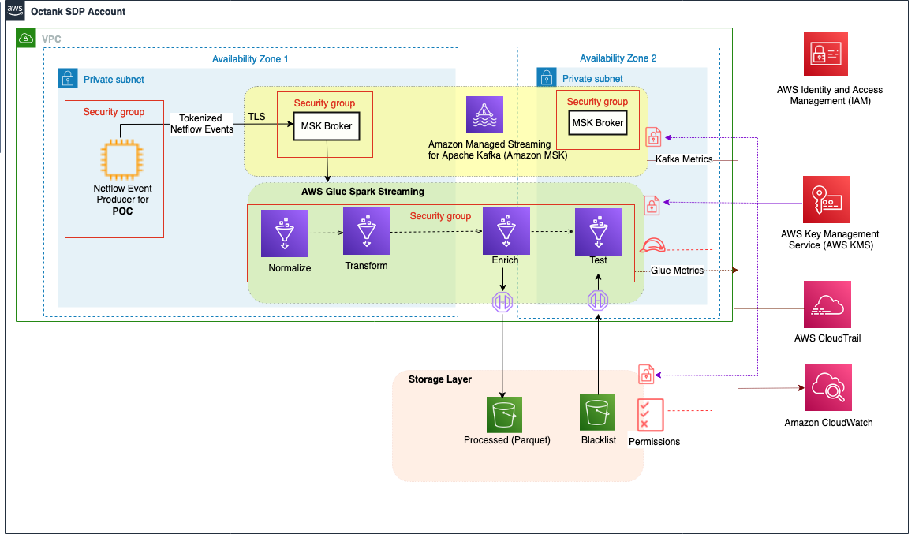
POC Architecture

Slide 6
Monitoring & Performance
Test # | 19 | TBD
Test Scenario | From kafka to s3/parquest - 1 enrichment (netzone + country code) (Retest Test 17) | From kafka to s3/parquest - 1 enrichment (netzone + country code) (Retest Test 20)
Process window (in sec) | 300 | 300
Avg events/second | 250,000 | 1,000,000
Avg processing time (in sec) | 1 | 270.16
Avg excess time (in sec) | 299.00 | 29.84
Number of partitions | 20 | 3000
Number of DPUs | 50 | 150
Number of producers | 1 | 4
Producer node type | m5.large / 1 instance | m5.2xlarge / 2 instance
Kafka Broker count | 10 | 20
Kafka Broker node type | kafka.m5.2xlarge | kafka.m5.8xlarge
Max Parquet file size (in MB) | 1.6 | 40
Kafka Broker node type | kafka.m5.2xlarge | kafka.m5.8xlarge
MSK Version | 2.62 | 2.62
Event Producer | python/confluent-kafka driver | python/confluent-kafka driver
Event Consumer | Glue/Pyspark 3.1 | Glue/Pyspark 3.1
Message Format | Avro Compressed | Avro Compressed
Compression | Snappy | Snappy

Slide 7
Pricing
Description | Service | Monthly | First 12 months total | Configuration summary
Kafka | Amazon Managed Streaming for Apache Kafka (MSK) | $16,631.68 | $199,580.16 | Storage per Broker (100 GB), DT Inbound: Internet (141 TB per month), DT Outbound: Not selected (0 TB per month), DT Intra-Region: (141 TB per month), Do you want to setup any Kafka Connect connectors? (No), Number of Kafka broker nodes (20), Compute Family (m5.2xlarge), Desired Provisioned Storage Throughput (MiBps) (800)
Glue | AWS Glue ETL jobs and development endpoints | $48,822.40 | $585,868.80 | Number of DPUs for Apache Spark job (150), Number of DPUs for Python Shell job (0.0625)
S3 (12 month online, 18 month offline) 1.7Pb month Std, 2.5PB Glacier - Cost p.a. approx. | S3 Standard | $3,245.27 | $38,943.24 | S3 Standard storage (141 TB per month)
S3 (12 month online, 18 month offline) 1.7Pb month Std, 2.5PB Glacier - Cost p.a. approx. | S3 Glacier Flexible Retrieval | $626.59 | $7,519.08 | S3 Glacier Average Object Size (40 MB), S3 Glacier storage (141 TB per month)
 | Amazon CloudWatch | $175.00 | $2,100.00 | Number of Metrics (includes detailed and custom metrics) (500), Standard Logs: Data Ingested (0 GB), Logs Delivered to S3: Data Ingested (100 GB)
Approx. Total Cost |  | $69,500.94 | $834,011.28
Notes:
* AWS Pricing Calculator provides only an estimate of your AWS fees and doesn't include any taxes that might apply. Your actual fees depend on a variety of factors, including your actual usage of AWS services.

Slide 8
Deployment Strategy
Notes:
Infrastructure as Code (IaC)

Slide 9
Deliverables of POC
Architecture design document
Pricing calculation sheet

Slide 10
Next Steps
Establishing project plan
Division of responsibilities and team composition
Analysis of a path to production and subsequent development
Notes:
I also propose that you need our engagement manager will work with you to establish project plan to identify right resources, availability of them from your side and our side also for project team.
Our engagement manager will also talk to you about team composition & the outcome of that will be a SOW define the way to move ahead
I will be available for you, incase you want to discuss & analyze the aspects of your future deployment when u are closer to production. Also if you have any questions for your subsequent workloads that you want to build at AWS cloud. I will be there to answer all of your questions on your cloud journey.
I think this was a good meeting. I have all information to build this POC and I hope I could propose you potential solution architecture.
Is there any other questions or concerns that you want me to take down as a note for future follow-up?
Thank you everyone for your time and participation.

